Slide 1
Android Programming Mobile Development
Dr Ian Drumm

Slide 2
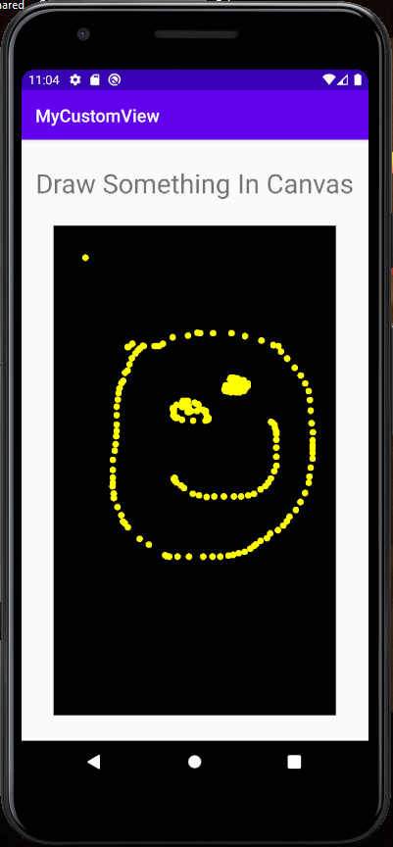
Graphics
Aims:
Drawing
Learning Outcomes:
Sub classing View
Canvas
Paint
Using a <view> widget
Touch Interaction

Slide 3
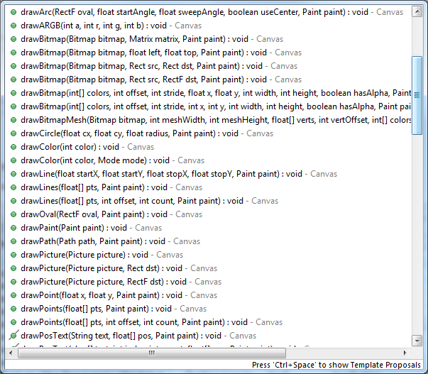
Canvas
The Canvas class holds calls to "draw" things

Slide 4
Paint
The Paint class holds the style and colour information about how to draw geometries, text and bitmaps.
Paint paint = new Paint();
paint.setColor(Color.RED);
canvas.drawCircle(500, 500, 100, paint);

Slide 5
Subclassing a View
One way to get a reference to a Canvas
public class MyView extends View {
private float x,y;
@Override
protected void onDraw(Canvas canvas) {
super.onDraw(canvas);
canvas.drawText("Hello", x, y, paint);
}
// getters and setters….
}

Slide 6
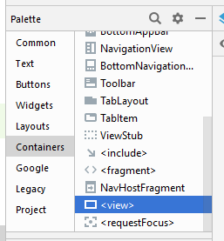
Adding your View object to your UI design
Can add a <view> a fragment’s xml
You hence can associate this with your custom MyView class

Slide 7
Access view from fragment
override the onViewCreated() method …
get a reference to myView via view.findViewById(…);
MyView myView; @Override public void onViewCreated(@NonNull View view, …) { super.onViewCreated(view, savedInstanceState);
myView = view.findViewById(R.id.your_view_id);
myView.somePublicMethod(); }

Slide 8
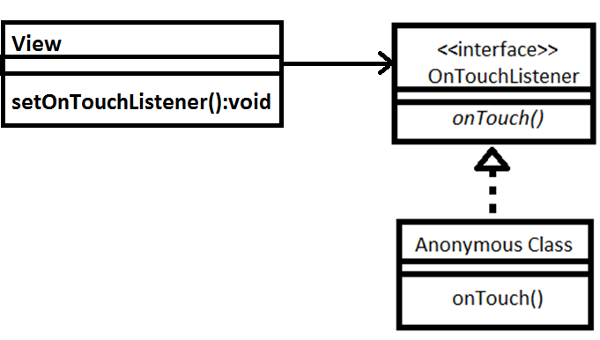
Interaction
Realise OnTouchListener interface implementing onTouch() method
Listener subscribes to the View object
setOnTouchListener(t1Listener);

Slide 9
Interaction
Instantiating the anonymous class
Callback sets x and y of the View object
OnTouchListener t1Listener = new OnTouchListener() {
@Override
public boolean onTouch(View v, MotionEvent event) {
v.setX(event.getX());
v.setY(event.getY());
v.invalidate();
return true;
}
};

